Slide 1
Course Title: Application Development Sessional Level -2 Semester- II Course Code: CSE 252
PRESENTATION ON THESIS PROGRESS
Project Tittle : Restaurant Billing System
Presented By
Partha Sarathi Roy-2120104
Md.Alamgir Hossain-2120108
GOVERNMENT SHAHID AKBAR ALI SCIENCE & TECHNOLOGY COLLEGE BALIADANGI, THAKURGAON

Slide 2
OUTLINE
Introduction
Objectives
Limitations
Scope
Design and Implementation
Challenges
Results And Outcome
Conclusion

Slide 3
INTRODUCTION
Overview:
A software application built using Java and Java Swing for managing restaurant bills.
It simplifies the ordering, billing, and payment experience for both the staff and customers.
Purpose:
To streamline the billing process, reduce human errors, improve efficiency, and provide a better customer experience.
Target Audience :
Restaurant owners, managers, and staff looking for effective billing and order management solutions.

Slide 4
OBJECTIVES
Automation: To streamline the billing process and reduce manual labor.
Accuracy: To ensure accurate calculations and prevent errors in billing.
Efficiency: To improve the speed and efficiency of service.
Customer Satisfaction: To enhance customer satisfaction through timely and accurate billing.

Slide 5
LIMITATIONS
No Add New Button: Not having an “Add New” button can be quite restrictive.
Only Change For Item: I understand correctly, This system allows changes only for existing items.
Only This Application Use Desktop: Modify this app only run desktop.

Slide 6
SCOPE
Order Management: Taking and processing customer orders.
Billing: Generating accurate bills based on customer orders.
Payment Processing: Handling various payment methods (cash).

Slide 7
DESIGN AND IMPLEMENTATION(CONT. )
Use Case Diagrams:
Place Orde
Calculate Bill
Customer
Make Payment
Receipt

Slide 8
DESIGN AND IMPLEMENTATION(CONT. )
Coding And Implantation Details:
Data Structures: Use Java data structures like arrays, Array Lists, to store information about menu items, orders.
Object-Oriented Design: Create classes for Order, Menu Item, and Customer to model the system's entities.
Event Handling: Use event listeners to respond to user interactions, such as button clicks or menu selections.
Calculation Logic: Implement algorithms to calculate total bill.
Printing Functionality: Utilize Java's printing capabilities to generate and print bills.

Slide 9
CHALLENGES
Scalability: The system's current design may need to be adapted to accommodate larger-scale restaurants with more complex operations and a higher volume of transactions.
Integration: Integrating the system with other restaurant management tools, such as point-of-sale systems or inventory management software.
Customization: The system may not be fully customizable to meet the specific needs of every restaurant, potentially requiring modifications or tailored solutions.
Security: Ensuring robust security measures to protect sensitive customer and financial data is a critical consideration.

Slide 10
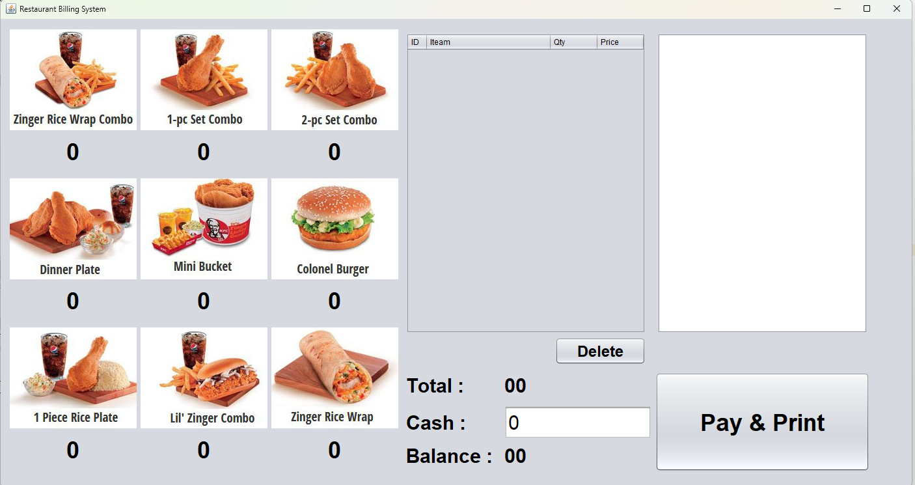
RESULTS AND OUTCOME (Cont. )

Slide 11
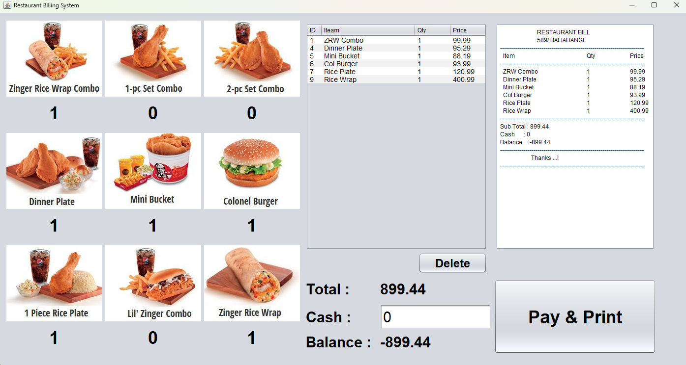
RESULTS and OUTCOME (Cont. )

Slide 12
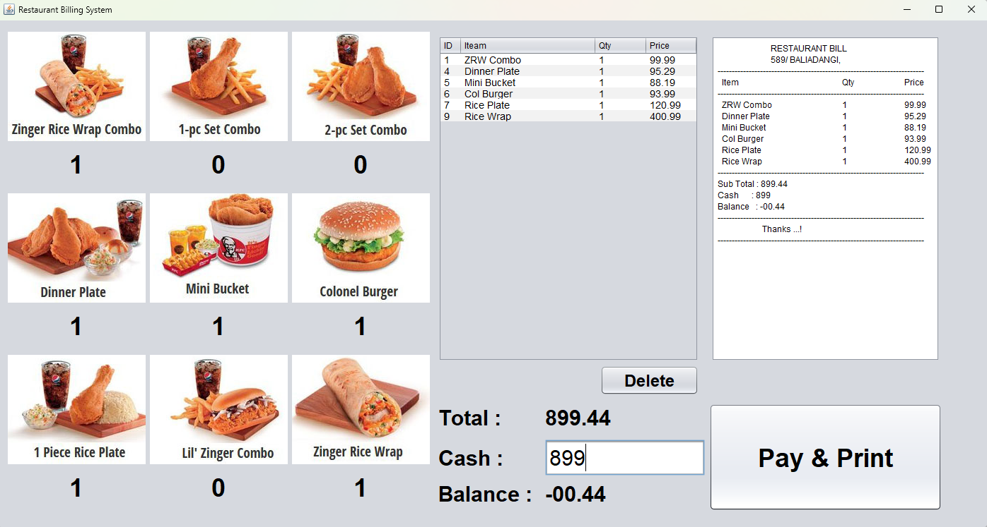
RESULTS and OUTCOME (Cont. )

Slide 13
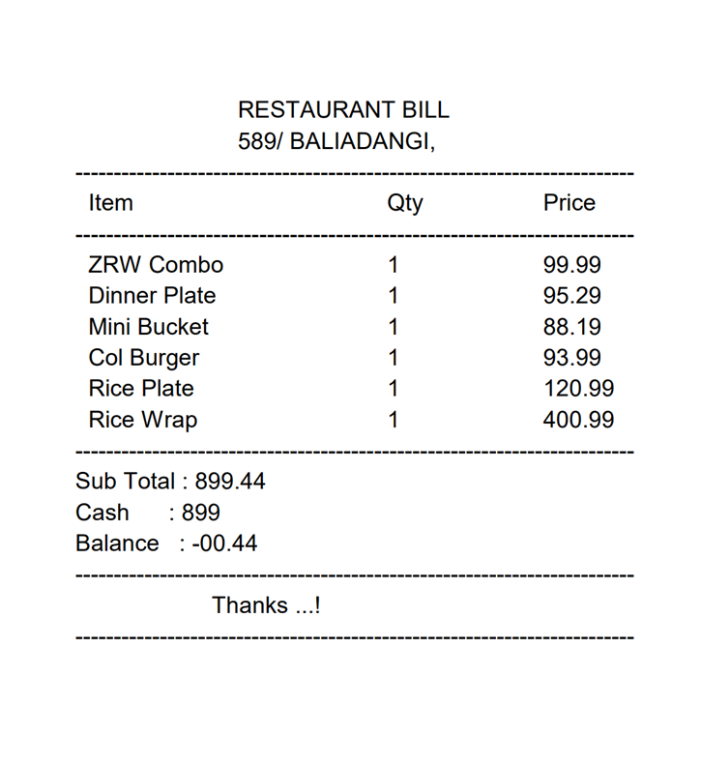
RESULTS and OUTCOME (Cont. )

Slide 14
CONCLUSION
The Restaurant Billing System, developed using Java and Java Swing, successfully simplifies and automates the billing process for restaurant staff.
The system provides an intuitive user interface, real-time item selection, accurate price calculation, and seamless receipt generation.

Slide 15


